Slide 1

Women's Tennis Association
MARIA ORLOVA

Slide 2
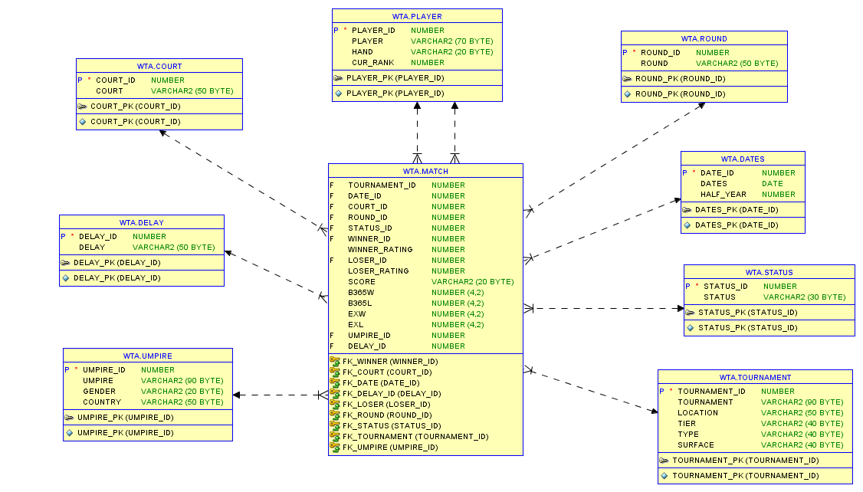
SCHEME

Slide 3
PLAYERS WITH LOW RATING, WHO BEAT TOP 5 PLAYER
WINNER | WINNER_RATING | LOSER | LOSER_RATING
Peng S. | 182 | Radwanska A. | 3
Zhang S. | 133 | Halep S. | 2
Chirico L. | 130 | Azarenka V. | 5
Cepelova J. | 124 | Muguruza G. | 2
Knapp K. | 118 | Azarenka V. | 5
Vesnina E. | 118 | Halep S. | 4
Pironkova T. | 102 | Radwanska A. | 2
Arruabarrena L. | 98 | Kerber A. | 2
Konjuh A. | 92 | Radwanska A. | 4
Zheng S. | 73 | Kerber A. | 2
Siegemund L. | 71 | Radwanska A. | 2
Allertova D. | 64 | Kerber A. | 2
Mchale C. | 62 | Muguruza G. | 4
Flipkens K. | 61 | Muguruza G. | 2
Bertens K. | 58 | Kerber A. | 3

Slide 4
PLAYERS WITH 3 OR MORE TITLES
PLAYER | TIER | TOURNAMENT | WINNER_RATING
Azarenka V. | Premier | BNP Paribas Open | 15
Azarenka V. | Premier | Brisbane International | 22
Azarenka V. | Premier | Sony Ericsson Open | 8
Cibulkova D. | SEC | BNP Paribas WTA Finals | 8
Cibulkova D. | International | Generali Ladies Linz | 10
Cibulkova D. | Premier | AEGON International | 21
Cibulkova D. | International | Katowice Open | 53
Halep S. | International | Bucharest Open | 5
Halep S. | Premier | Mutua Madrid Open | 7
Halep S. | Premier | Rogers Cup | 5
Kerber A. | Grand Slam | US Open | 2
Kerber A. | Grand Slam | Australian Open | 6
Kerber A. | Premier | Porsche Tennis Grand Prix | 3
Radwanska A. | Premier | Connecticut Open | 4
Radwanska A. | International | Shenzhen Open | 5
Radwanska A. | Premier | China Open | 3
Stephens S. | International | ASB Classic | 30
Stephens S. | Premier | Family Circle Cup | 25
Stephens S. | International | Abierto Mexicano | 24

Slide 5
VICTORY PERCENTAGE BY MONTH

Slide 6
WHITEMASH MATCHES
TOURNAMENT | ROUND | WINNER | WINNER_RATING | LOSER | LOSER_RATING | SCORE
Qatar Total Open | 1st Round | Vekic D. | 104 | Al Nabhani F. | 378 | 6-0, 6-0
French Open | 1st Round | Wang Q. | 74 | Andrianjafitrimo T. | 311 | 6-0, 6-0
BNP Paribas Open | Quarterfinals | Azarenka V. | 15 | Rybarikova M. | 97 | 6-0, 6-0
Porsche Tennis Grand Prix | 1st Round | Kvitova P. | 7 | Chirico L. | 121 | 6-0, 6-0
Abierto Mexicano | 1st Round | Cibulkova D. | 66 | Dominguez Lino L. | 105 | 6-0, 6-0
TEB BNP Paribas Istanbul Cup | 1st Round | Sevastova A. | 96 | Krunic A. | 120 | 6-0, 6-0
Bucharest Open | The Final | Halep S. | 5 | Sevastova A. | 66 | 6-0, 6-0
US Open | 1st Round | Suarez Navarro C. | 12 | Pereira T. | 136 | 6-0, 6-0
Australian Open | 1st Round | Azarenka V. | 16 | Van Uytvanck A. | 43 | 6-0, 6-0

Slide 7
PERCENT OF WINS ON DIFFERENT SURFACES FOR TOP 5
PLAYER | SURFACE | Percent of wins, %
Kerber A. | Clay | 61,54
Kerber A. | Grass | 80
Kerber A. | Hard | 78
Kerber A. | All surfaces | 75,34
Williams S. | Clay | 91,67
Williams S. | Hard | 81,82
Williams S. | Grass | 100
Williams S. | All surfaces | 91,16
Radwanska A. | Clay | 62,5
Radwanska A. | Grass | 62,5
Radwanska A. | Hard | 78,18
Radwanska A. | All surfaces | 74,65
Halep S. | Clay | 82,35
Halep S. | Grass | 80
Halep S. | Hard | 67,57
Halep S. | All surfaces | 72,88
Cibulkova D. | Clay | 80
Cibulkova D. | Grass | 90
Cibulkova D. | Hard | 63,64
Cibulkova D. | All surfaces | 71,62

Slide 8
BOOKMAKER ERROR
LOCATION | TOURNAMENT | ROUND | WINNER | LOSER | B365W | B365L | EXW | EXL
Melbourne | Australian Open | 1st Round | Putintseva Y. | Wozniacki C. | 8 | 1,08 | 7 | 1,08
Brisbane | Brisbane International | 2nd Round | Crawford S. | Bencic B. | 9 | 1,06 | 8 | 1,07
Paris | French Open | 1st Round | Knapp K. | Azarenka V. | 15 | 1,03 | 10 | 1,02
Madrid | Mutua Madrid Open | 3rd Round | Chirico L. | Azarenka V. | 8 | 1,08 | 7 | 1,07
Shenzhen | Shenzhen Open | 1st Round | Zheng S. | Kvitova P. | 10 | 1,05 | 8 | 1,06
Melbourne | Australian Open | 1st Round | Zhang S. | Halep S. | 10 | 1,06 | 8 | 1,07

Slide 9
Thanks for your attention!

